Slide 1

Please Read
Use Segoe UI as font and keep font sizing the same as this slide
Do not over fill slide with text
Layout must be consistent with THIS slide format use ctrl+d to duplicate this slide
Relevant content only please
We have a 15 minute slot for presentation – but we may need time for set up and demo so this should be considered in timings
Current slides are NOT final (some may just be outlines) please add any changes
01 Oct. 2019

Slide 2
Industrial Team Project
Team 5 – Sarah Small, Cyril Varghese, Douglas Parkinson, Oliver Simpson, Owen Kelbie and Songlin Jin
01 Oct. 2019

Slide 3
Understanding the Problem
The needs we are trying to address with this product are:
ability to find the cheapest price for a procedure/condition
ability to restrict the search based on location (either live location or based on user input)
ability to order results based either on price or distance
01 Oct. 2019

Slide 4
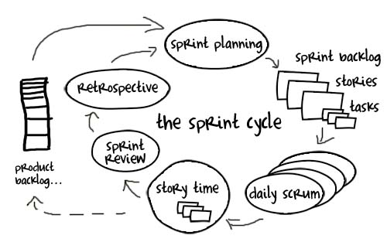
Our Approach
Agile methodology
3 Sprints (1 week duration)
Planning
Daily Scrum
Review
Retrospective
Team Roles
Team Leader
Team divided into frontend and backend
01 Oct. 2019

Slide 5



Tools
Pivotal tracker – Agile project management
User stories
Product backlog
Burndown & other analytics
Track progress
GitHub – Source control
Tettra – Team Wiki
Any notes or documentation about the project are stored here.
This includes: the logbook, technical notes and designs
01 Oct. 2019

Slide 6




Frontend
Angular application
Services – retrieve and send data using the APIs
Components e.g. search bar, table, map
Some components may use some of the data provided by the services
Libraries
Material design & MDB bootstrap
Google API
this is used for the map, autocomplete locations and hospital reviews
01 Oct. 2019

Slide 7



Backend
Node.js server using express framework
Dynamic queries
Exposes endpoints
Acts as RESTful API
MySQL database
Data split into different tables
One for each year
Providers
Procedures
Data Normalised
01 Oct. 2019

Slide 8


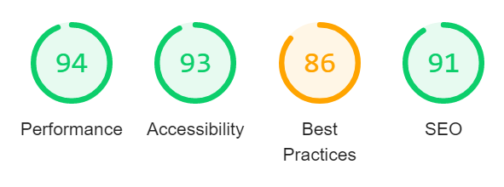
Testing
Unit testing – mocha
Test specification
Lighthouse
01 Oct. 2019

Slide 9
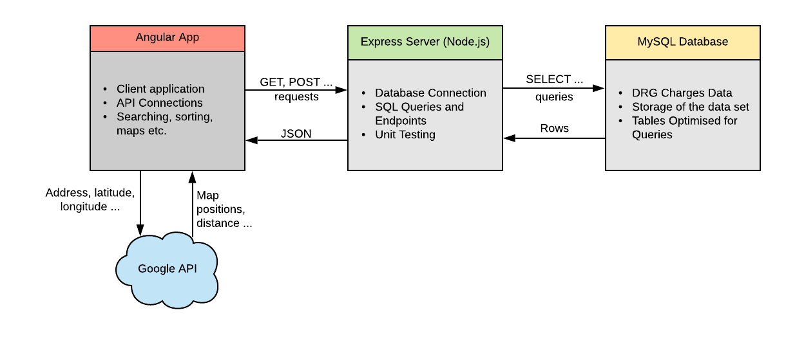
System Architecture
01 Oct. 2019
Notes:
This is an overview of our system architecture

Slide 10
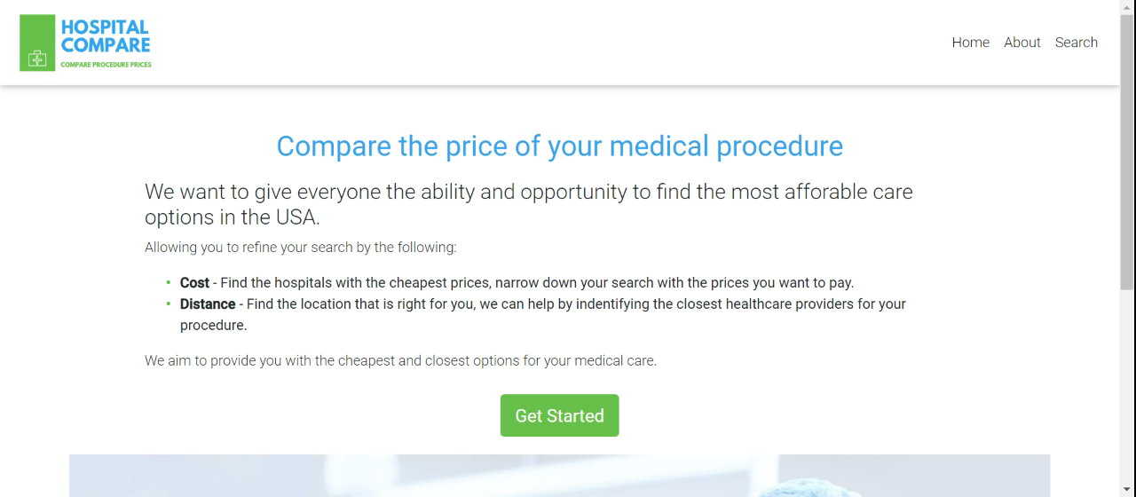
Notes:
This is a placeholder video – to record a video on chrome download the nimbus chrome extension – its really good☺

Slide 11
User Evaluation
Two types of testing:
System usability scale
A simple overall check of a sites friendliness to new users without instruction
Comparable data to other websites and useable continuing metric for retests of your sites readability
Task testing using the NASA-TLX
A more specific and difficult test requiring users to complete task that provides much more focused data on the site usability and complexity
The NASA-TLX scale is a simple scale for evaluating any project that has reputable example in computing
More specifically shows what areas you are lacking in
01 Oct. 2019
Notes:
Change image to actual

Slide 12
Future work & next steps
Really pleased with current work and methodologies
Future expansions for this work
Admin functionality
Increased website security for external hosting
Data prediction through machine learning
01 Oct. 2019

Slide 13
Questions?
01 Oct. 2019

